Slide 1
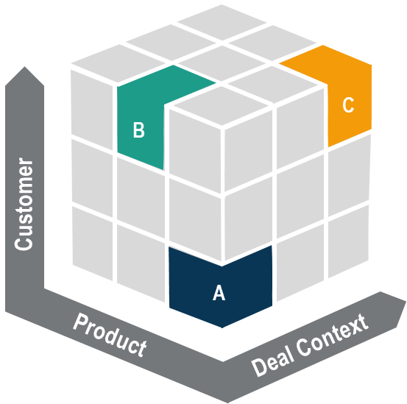
Dynamic Model | We combine data science and strategic guidance to improve decision quality
Model Inputs
Segmentation
Parameters
Outputs
Internal Data
Transactions
Customer/Product
Identify which patterns drive behavior
Differentiate position across segments
Predict price and response
Lever
A
B
C
Price | Win Rate
$17.96 | 43%
$16.73 | 46%
$18.44 | 39%
Customer Importance | +2.5% | - | -
Product Importance | - | -3.0% | +1.2%
Volume Trend | -1.7% | +2.3% | -
End Market | +3.4% | - | -2.6%
A
External Data
Market Response
Sentiment Analysis
B
Industry Expertise
Benchmarks
Key Drivers
C
In-House Knowledge
Internal Expertise
+
Coupled with Strategic Guidance
Distill commercially viable segments
Align position with priorities
Adjust intelligently

Slide 2










Intelligent Resolution | Translates ambiguous customer requests into configured quotes
Option 1
1. INBOUND REQUEST
2. RESOLUTION AGENT
3. CONFIGURED QUOTE
Customer submits unstructured quote request with raw product description
Parses, normalizes & cross-references product master using multi-layer matching
Verified SKU returned with pricing across all requested quantities
LIVE EXAMPLE · END-TO-END SKU RESOLUTION
CUSTOMER REQUEST
AI RESOLUTION
RESOLVED OUTPUT
FROM:
buyer@industrialco.com
Token Extraction
MATCHED SKU
SUBJ:
Quote Request — Insulators
Parses email into structured attributes: product type, voltage, thread spec, vendor, model number
STAOFFR4225A5
"I need price for the following: INSULATOR, 2.7KV, 3/8-16,
MAR-BAL, R4225-S5
Quote quantities:
1 / 5 / 10 / 25 / 50 / 100"
Unit Normalization
STANDOFF, R4225, 2700V, 2.25"H, 3/8×16×9/16
2.7KV → 2700V | Resolves aliases, abbreviations & measurement unit conversions automatically
FROM EMAIL
→
PRODUCT MASTER
INSULATOR
✓
STANDOFF (Rigid Insulation)
Fuzzy SKU Lookup
2.7KV
≡
2700V (unit converted)
Cross-references product master with normalized tokens; ranks candidate SKUs by match confidence
3/8-16
✓
3/8×16×9/16 (thread)
⚠ RESOLUTION CHALLENGES
Variant Disambiguation
MAR-BAL
✓
MAR-BAL INC. (vendor)
2.7KV ≠ catalog format • 3/8-16 ambiguous • Suffix variant (S5 vs A5)
Resolves suffix variants (S5→A5) and eliminates incorrect alternatives (M10 metric thread rejected)
R4225-S5
≈
R4225A5 (model + variant)
✓ HIGH CONFIDENCE MATCH · METRIC VARIANT REJECTED

Slide 3
Intelligent Resolution | Translates ambiguous customer requests into configured quotes
EXAMPLE: Specialty Parts Manufacturer
Configuration Complexity
Define Key Inputs
Resolution Algorithm
Existing logic overcomplicates configuration without improving quality of recommendation
We use data science to identify key value drivers
And translate ambiguous customer requests into configured quotes; facilitating iteration where additional context is needed
Quote Details
Customer
End market
Customer importance
Product
Key material
Finish material
Thickness
Hardware
Quantity
Deal Context
Leadtime
Plant capacity
“We are looking for pricing for a prototype build of an IC substrate for a new semiconductor package program.
Please see the preliminary requirements in the attached file.
Preferred delivery in 4-5 weeks.”
Key material
Finish material
Array
Aspect ratio
Thickness
Milling
Hardware
Epoxy layers
Threads
Drill cycles
Cavities
Hole types
Plated edges
Bind cycles
Scoring
Tolerance
Solder mask
Color mask
Vacuum seal
Sub-assembly
Finish thickness
Stiffener
Hole types
Counter bore
Quantity breaks
Rush order
Inbound Request
6 / 8
Token Extraction
+
Fuzzy Match Logic
+
Variant Disambiguation
=
Resolution Algorithm
Inputs Identified
86% Confidence
98% Confidence
Confidence Score
User Context Iteration

Slide 4
Dynamic Model – Scenario Examples
WIP
Differentiated Recommendations
Feedback + Tuning
Dynamic Response
Inputs / Segment
Market Response
Adjustment
Inputs / Segment
A:
$17.96
Volume: Flat
Win-Rate: Up
++
A2:
$19.24
Strategic Customer
Specialized Product
High Product Mix
Industrial End Market
40% Win Rate
Strategic Customer
Specialized Product
High Product Mix
Industrial End Market
43% Win Rate
B:
$16.73
Volume: Down
Win-Rate: Down
-
B2:
$14.89
Strategic Customer
Specialized Product
Low Product Mix
Healthcare End Market
40% Win Rate
Strategic Customer
Specialized Product
Low Product Mix
Healthcare End Market
38% Win Rate

Slide 5
AI Techniques | ML and Gen AI play different roles in a complete pricing solution
Machine Learning
^{v.}
Generative AI
Data Type | Structured Input Data Transactions, discounts, customer segments | Unstructured Input Data Works best with information like emails, notes, comments
Core Capability | Prediction and Forecasting Price sensitivity, win probability, demand response | Summarization and Contextualizing Recommendation explanations, sentiment analysis
Logic Mechanism | Deterministic and Repeatable The same model and inputs provide the same output | Non-Deterministic Can provide different outputs given the same input
Business Application | Data-Driven Recommendations Optimizes for the best output given known constraints | Natural-Language Reasoning Supports data-driven workflows to improve usability

Slide 6
Dynamic Model |
v1
Static Decision Logic
Dynamic Decision Logic
Price
Price
A2: $19.24
Strategic Customer | Specialized Product | 46% Win Rate | High Product Mix
A: $17.96
A: $17.96
Strategic Customer | Specialized Product | 40% Win Rate | High Product Mix
B: $16.73
Strategic Customer | Commodity Product | 40% Win Rate | Low Product Mix
Revenue $
Revenue $
B2: $14.89
Strategic Customer | Commodity Product | 37% Win Rate
Volume
Volume

Slide 7
Dynamic Model | Evolves with changing market conditions and objectives to maximize profit
Dynamic Segmentation to Match Value Proposition
Dynamic Model Adjusts for Evolving Market Conditions
Price
Price
Original Output
Cust 1: $19.24
Cust 1: $18.79
Cust 2: $17.96
Cust 2: $17.96
Cust 3: $17.05
Cust 3: $16.73
Cust 4: $14.89
Cust 4: $15.20
Revenue $
Revenue $
Demand
Demand

Slide 8
Dynamic Model |
INPUTS
SEGMENTATION
PARAMETERS
OUTPUTS
A
B
C
Price Reco | P. Win Rate
$17.96 | %
$16.73
$18.44
Internal Data
Customer Importance | +2.5% | - | -
Product Importance | - | -3.0% | +1.2%
Volume Trend | -1.7% | +2.3% | -
End Market | +3.4% | - | -2.6%
A
B
Customer
External Data
INSIGHT Industry Expertise
C
Consumption
Deal Context
Business Expertise
+ Strategic Guidance
Commercially Viable Segments
Priority Aligned Parameters
Intelligent Market Response

Slide 9
Dynamic Model |
Model Inputs
Segmentation
Parameters
Outputs
Identify which patterns drive behavior
Differentiate position across segments
Predict price and response
Internal Data
Lever
A
B
C
Price | Win Rate
$17.96 | 43%
$16.73 | 46%
$18.44 | 39%
Customer Importance | +2.5% | - | -
Product Importance | - | -3.0% | +1.2%
Volume Trend | -1.7% | +2.3% | -
End Market | +3.4% | - | -2.6%
A
External Data
B
Industry Expertise
C
In-House Knowledge
+
Coupled with Strategic Guidance
Distill commercially viable segments
Align position with priorities
Adjust intelligently

Slide 10
Item Resolution |
WIP
Configuration Complexity
Key Inputs
“Intelligence”
Product Details
Incremental Effort
Incremental Value
Customer
Attribute 1
Attribute 2
Product
Attribute 3
Attribute 4
Attribute 5
Deal Context
Attribute 6
Attribute 7
Attribute 8
Inbound request -> parse inputs
Attribute 1
Attribute 2
Attribute 3
Attribute 4
Attribute 5
Attribute 40
Resolve ambiguity, assess historic context, enhance data
High Confidence
(Autonomous)
Mod/Low Confidence
(Iterate)

